Slide 1
Washington Update: Politics, Policy and Issues to Watch
Michael J. Regier
Vice President, Legal Affairs and Chief Legal Officer
Health Care Supplier/Provider Institute
August 23, 2012 – Chicago, IL

Slide 3
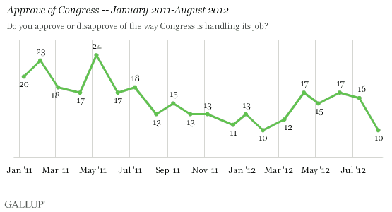
The Bad News, Part 1: Congress Job Approval at an All-Time Low
Ties Previous Low
Set in February 2012

Slide 4
The Bad News, Part 2: All-Time High Anti-Incumbent Sentiment
Will Current Viewpoint Prevail
At Ballot Box in November?

Slide 5
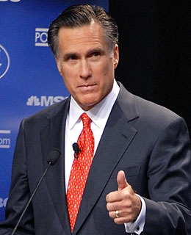
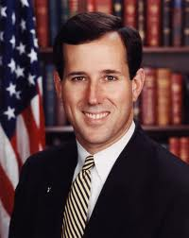
Bruising Republican Primary Battle

Slide 6
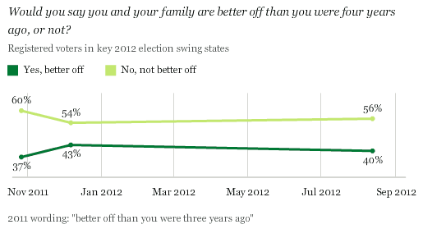
Swing State Sentiment Souring?
Nearly 60% of Swing State Voters
Say Not Better Off Now

Slide 7
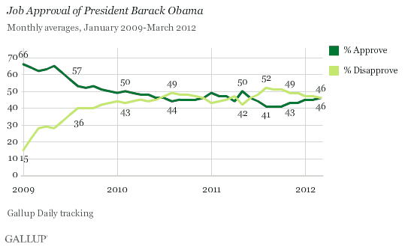
President’s Job Approval Remains Relatively Flat
Now 47% Approval;
Can 50% or Higher Be Attained?

Slide 8
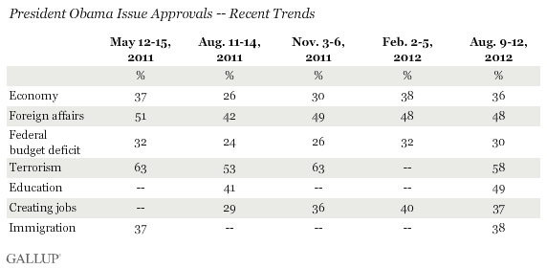
Critical Factor for President Obama: The Economy (Stupid)
President’s Lowest Ratings on
Deficit Reduction, Jobs and Economy

Slide 10
The Big Picture (and Impact): Shift Risk to Providers (and Patients)
Pay for Performance
Payments tied to objective performance metrics
LOWER RISK
HIGHER RISK
2011-2012
Launch of hospital value-based purchasing program in Medicare
Medicaid bundled payment demonstrations
Allow Accountable Care Organizations that meet quality thresholds to share in Medicare cost savings
Today
Pay for service model is predominant
2013-2014
Medicare bundled payment pilot
Capitation
Pay for Service
Providers share savings from better coordination and management
Providers are paid for each unit of service
Shared Savings
Episodic Payments
Shared savings from better care coordination and mgmt
Payments based on care delivery within timeframe
Source: HFMA, Kaiser Family Foundation

Slide 11
The Big News: NFIB v. Sebelius
The Anti-Injunction Act
Does not apply
The Individual Mandate
Upload (Constitutional)
Dismissed – ACA Implementation Continues
Strike Down
(Unconstitutional)
Medicaid Expansion
Severable
Not Severable
Dismissed – ACA Overturned
Upload (Constitutional)
Strike Down
(Unconstitutional)
If the Individual Mandate is ruled severable, other provisions can continue to be implemented.
Severable
Not Severable
Applies
The Individual Mandate
If Medicaid Expansion is ruled severable, it will be overturned and the rest of the law will depend on the individual mandate decision.
Medicaid Expansion
Strike Down
(Unconstitutional)
2014
Severable
Not Severable
Dismissed – ACA Overturned
Upload (Constitutional)
If Medicaid Expansion is ruled severable, it will be overturned and the rest of the law will depend on the individual mandate decision – at the earliest in 2014.

Slide 13
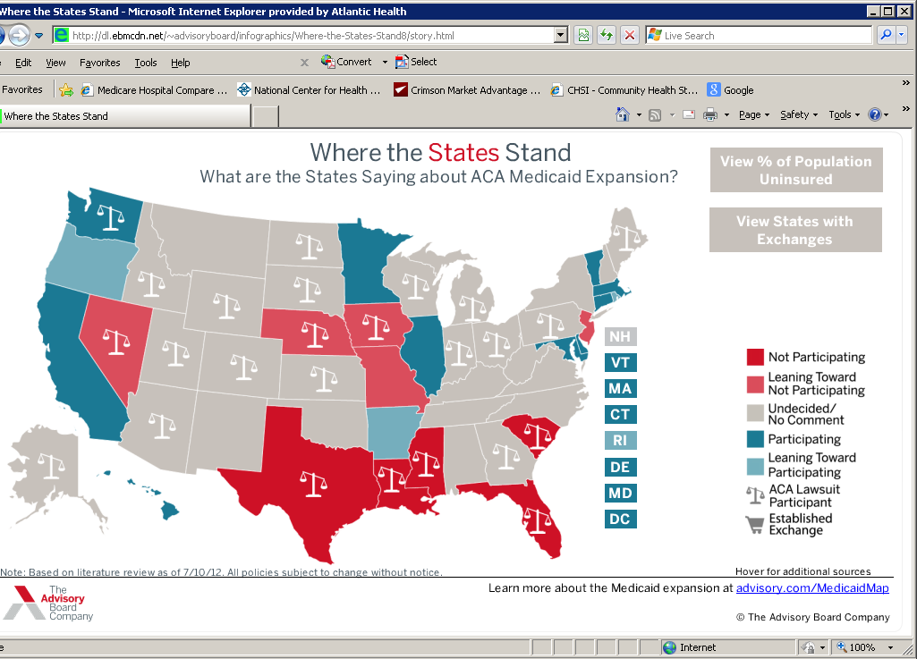

Slide 14
Major Milestones in Implementation Process
Rulemaking Aimed at Key Policy Objectives
Get What We’re
Paying For
Hospital payment reductions begin ($155B over 10 yrs)
Value-Based Purchasing finalized (some lose up to 2%)
Partnership for Patients Launched
Health Care Innovation Challenge Grants Awarded
Only Pay for Appropriate,
Clinically Effective Care
PCORI Executive Director and Board appointed
IPAB Stalled, Repeal Effort Underway
Don’t Tolerate Waste, Fraud or Abuse
Mandatory Compliance Programs
Provider Screening Process
60-Day Repayment Requirement in Effect
Use Payment Policy to
Drive Care Coordination
Medicare Shared Savings Program: Final Rules; Pioneer ACOs announced; “Plain Vanilla” ACOs announced
First Bundled Payment Solicitation Released 2011

Slide 15
Key Components to Highlight
Value Based Purchasing
Budget neutral program would initially put at risk 1% of payments (not just on selected measures) for performance on selected quality measures. (Final Rules 04/29/2011)
Performance measures largely the same for FY2013 and FY2014; initial performance measurement period remains same; weighting remains same (70% Clinical Process of care, 30% HCAHPS scores)
CMS estimates 353 hospitals (about 11.4% of those that will participate) will receive no VBP incentive payments.
CMS data also suggests that where Medicare represents 25-50% of volume, hospitals on average will receive only about 40% of the at-risk amount; for those with Medicare volume of 50-65%, hospitals on average will receive about 67% of at-risk amount.
.

Slide 16
Key Components to Highlight
Accountable Care Organizations
Final Rules released (Oct. 20, 2011) http://www.ofr.gov/OFRUpload/OFRData/2011-27461_PI.pdf
IRS Guidance: http://www.irs.gov/newsroom/article/0,,id=248490,00.html
FTC/DOJ: http://www.ftc.gov/os/fedreg/2011/10/111020aco.pdf
OIG/CMS: http://www.ofr.gov/OFRUpload/OFRData/2011-27460_PI.pdf
Significant Changes from Initial Proposal
Payment models
EHR requirements
Measurements
Management and governance
Savings splits
To date CMS has designated 65 ACOs (approx. 1.1 million beneficiaries):
32 Pioneer Model (Dec. 22, 2011)
27 MSSP ACOs (Apr. 10, 2012) (including 6 Advance Payment Model)
6 Physician Group Practice Transition Demonstrations
Per CMS, more than 150 applications for MSSP for July 1, 2012 start-date (includes more
than 50 applications for Advance Payment Model)

Slide 17
Key Components to Highlight
Global or Bundled Payment
Starting Jan. 1, 2012, HHS to establish a five year Medicaid bundled payment demonstration project; will run in up to 8 states and focus on conditions to be selected/specified by states– Regulations/solicitation in 2013?
Starting Jan. 1, 2013, HHS to establish a five year Medicare national voluntary pilot project on bundled payment; to include ten conditions yet to be specified; will include pre-admission, hospital, physician and post-acute care initiated within 30 days post-discharge.– Bundled Payments for Care Improvement Initiative (released on Aug. 23, 2011). Providers invited to propose on four different models:
Model 1 (Acute Care Stay)
Model 2 (Acute Care Stay plus Post-Acute Care)
Model 3 (Post-Acute Care Only)
Model 4 (Acute Care Stay—Prospective Payment)

Slide 18
Most Recent Developments:
HHS Final Blueprint—State Insurance Exchanges
(Publication Date: Aug. 16, 2012)
States can establish own exchange, or a state partnership exchange (using plan management or consumer assistance)
HHS will establish and operate a Federally-facilitated exchange in any state that that elects not to operate an exchange
States must file complete and file an exchange blueprint demonstrating how it meets/will meet all legal and operational requirements
Applications due by Nov. 16, 2012
HHS must approve/conditionally approve state-based exchanges not later than Jan. 1, 2013 for operation in 2014.

Slide 19
Most Recent Developments:
Hospital Readmissions Reduction Program
(Effective Date: Oct. 1, 2012)
Based on 30-day readmissions for heart failure, myocardial infarction and pneumonia patients from July 2008 to June 2010
278 hospitals will lose 1% of their base Medicare payments (maximum allowed by the ACA)
1,933 hospitals will lose between 0.01% and 0.99% of their base Medicare payments
1,156 will lose no payments
Cuts disproportionately affect safety-net hospitals

Slide 21
“Top Five” (+2) Issues
Presidential election
CMS in Transition
The 501(c)(3) Exemption
Budget Control Act Cuts
Impact of Medicaid Expansion
Progress on Insurance Exchanges
Disruptive Delivery Technology

Slide 23
Hospitals
Clinical integration AND shared governance required in the accountable care environment (whether or not an ACO); but both are counter-cultural
VBP in effect now for acute care hospitals; other payment reductions will soon occur (nearly 10% of Medicare reimbursement at risk by 2015)
More payment cuts possible to offset reduction in Budget Control Act sequestration cuts and full/partial extension of Bush-era tax status
Demographic shift and uncertainty of Medicaid expansion will greatly enhance current margin pressure.
Continued need to defend and justify tax-exempt status
Current consolidation trend may be placing undue emphasis on hospital facilities, beds
Overall: More potential downside than upside

Slide 24
Physicians
SGR “fix” temporarily deferred, but no easy resolution in sight.
Increased transparency about quality (PhysicianCompare) will increase consumer awareness and scrutiny
Will transition to VBP eventually and on budget-neutral basis
Primary care role critical in ACO environment; yet primary care capacity and supply are severely constrained
Coverage expansion = Medicaid expansion (if it occurs) = Poor Payor, which further disincents physician participation
Scarce resources will force hospitals to pick partners more carefully
Potential opportunity for those rapidly moving toward payments based on value
Overall: Slight positive for primary care; negative for specialists

Slide 25
Suppliers
Policy priority has been medical device sector tax
View of reform: More insurance coverage = more sales, therefore, WE WIN!!
Must price with view to customer’s reimbursement trends
VBP environment may offer strategic pricing opportunities
Impact of comparative effectiveness research as yet unknown
Further Congressional scrutiny possible (following Baucus investigation of Medtronic and GAO study on price transparency involving physician preference-items)
FTC review of sector likely to occur at some point
Overall: Neutral to slight positive, with clouds on horizon

Slide 26
Insurers
Dodged an actuarial bullet with ruling on individual mandate
Adverse selection risk remains high, even with mandate being upheld
Federal rate review process will constrain ability to use premium increases to compensate for adverse loss experience
Exchange requirements for “minimum essential benefits” will add expense
Exchange start-up could worsen cost-shifting and further destabilize markets
Potential new market opportunities (e.g., administering bundled payment arrangements for providers)
Overall: Neutral to slight positive, with clouds on horizon

Slide 27
Washington Update: Politics, Policy and Issues to Watch
Michael J. Regier
Vice President, Legal Affairs and Chief Legal Officer
Health Care Supplier/Provider Institute
August 23, 2012 – Chicago, IL

